Slide 1
CDC Clinical Standardization Programs
Hubert W. Vesper, Ph.D.
Director, Clinical Standardization Programs
Division of Laboratory Sciences

Slide 2
CDC’s Clinical Standardization Programs help laboratories and manufacturers to improve and maintain the accuracy and reliability of laboratory tests
Assay Manufacturer
Clinical Laboratory
Accurate and reliable
Patient Result
Calibrate and Evaluate
Monitor and Verify
CDC Clinical Standardization Programs

Slide 3
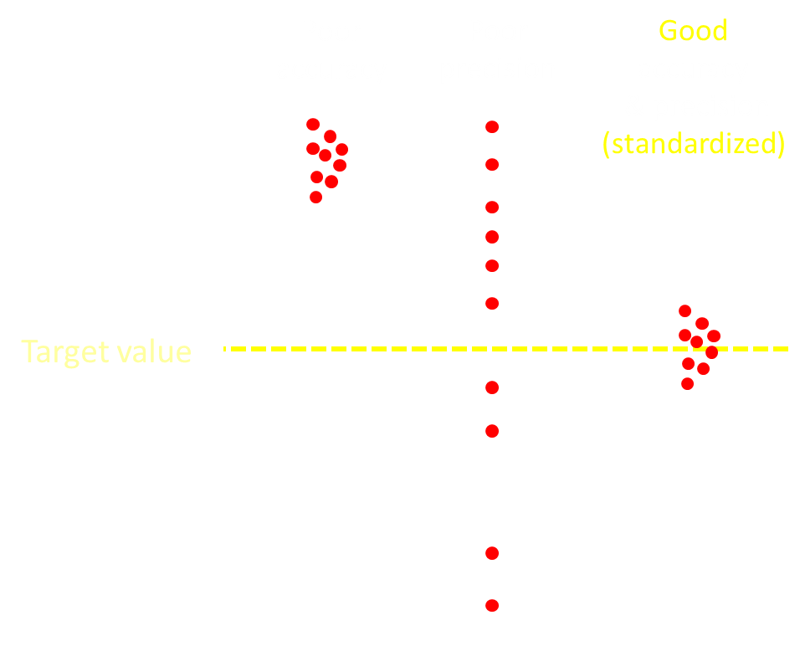
Hormone tests need to be accurate and precise to correctly diagnose and treat patients
Laboratory measurements
are the sole source of information
for diagnosis and treatment of many endocrine diseases

Slide 4
CDC improves patient care and public health by ensuring laboratory measurements are accurate and reliable
Clinical Standardization Programs - Goal
Improve diagnosis, treatment, and prevention of selected diseases by standardizing clinical laboratory measurements
Clinical Standardization Programs - Objective
Create measurement results that are traceable to one accuracy point and thus are comparable across
methods,
location, and
over time
Notes:
Focusing on accurate measurement results stimulates innovation

Slide 5
Standardization/Harmonization Steps
Develop and maintain
reference methods
CDC Clinical Reference Laboratories
Calibrate and evaluate manufacturers
CDC Certificates Programs
Monitor accuracy of clinical laboratories
CDC Laboratory Monitoring Programs
Proficiency Testing Programs

Slide 6
CDC is harmonizing 8 important laboratory measurements
 | Accuracy Precision
Total Cholesterol | ±1.0% ≤1%
LDL-Cholesterol | ≤2% ≤1.5%
HDL-Cholesterol | ≤1.0 mg/dL ≤1 SD
Triglycerides | ≤2.5% ≤2.5%
25-Hydroxyvitamin D2 25-Hydroxyvitamin D3 | ±1.7% ≤5.0%
Testosterone | ±2.1% ≤2.7%
Estradiol | ±2.8% ≤5.7%
Notes:
CDC has unique laboratory methods optimized for high accuracy and preicsion

Slide 7
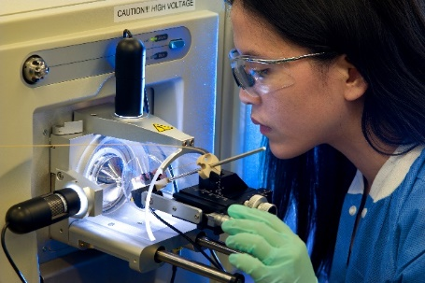
CDC is developing new harmonization programs
Thyroid stimulating hormone
Thyroid hormones
Parathyroid hormones
More are in needed
Notes:
CMS spent $666 M in 2014 on these tests

Slide 8
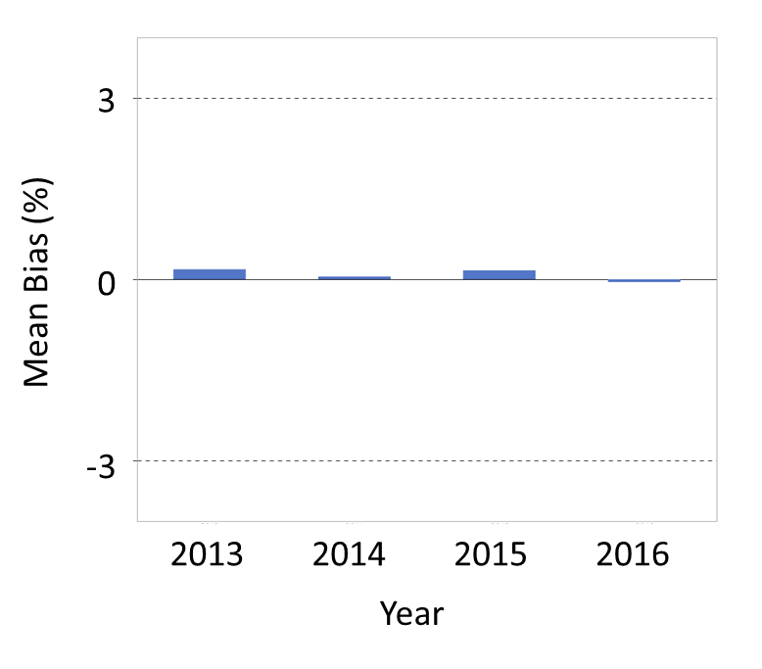
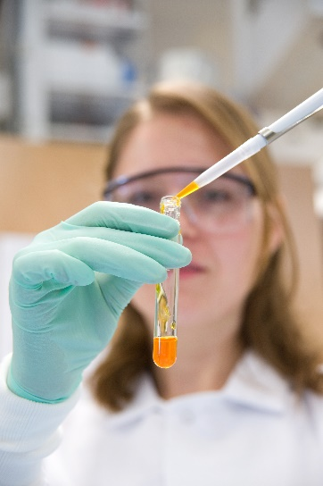
Cholesterol measurements show excellent accuracy over time in the CDC Lipids Standardization Program
Maximum allowable bias
Maximum allowable bias
Notes:
CDC Programs lead to accurate measurements in patient care

Slide 9
Vitamin D assays standardized by CDC showed less inaccuracy in patient care than non-standardized assays
CDC Standardized
Not CDC Standardized
Data from 2017
Notes:
CDc standardized tests are better than non standardized tests

Slide 10
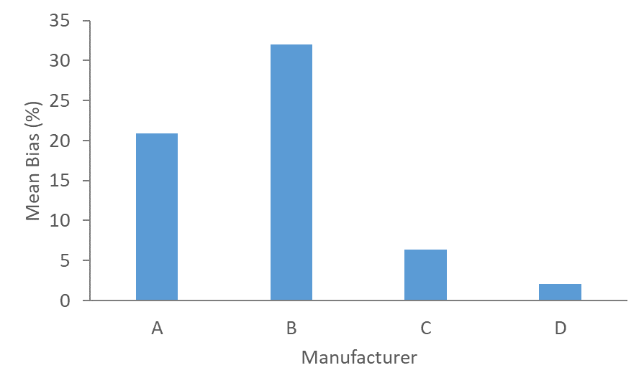
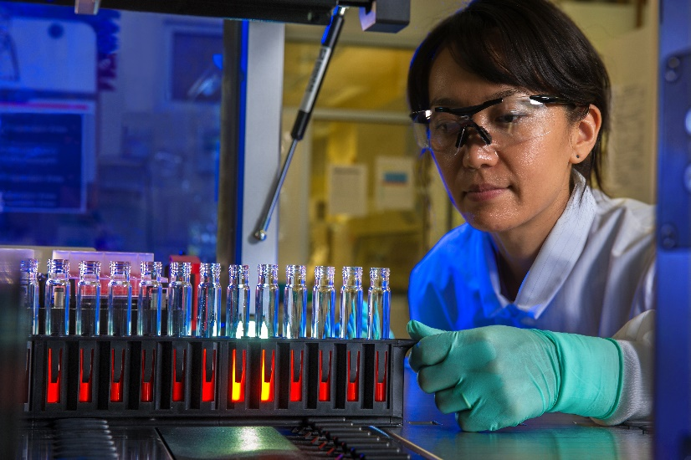
Testosterone tests standardized by CDC showed better accuracy than non-standardized tests in 2018
Standardized
Notes:
Manufacturers that are standardized perform better in patient care
We currently have accurate and less accurate assays used in patient care.

Slide 11
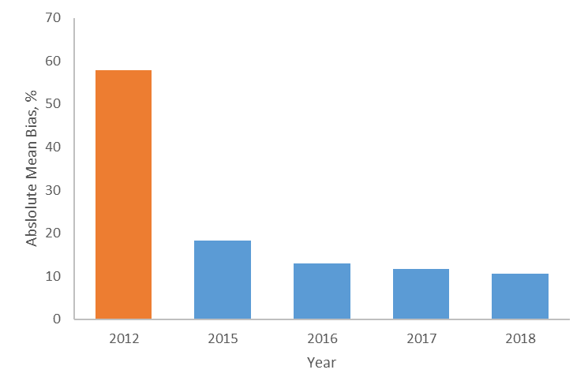
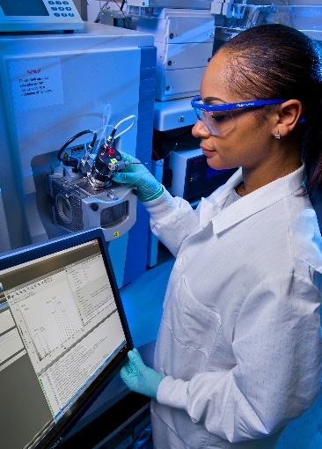
Estradiol measurements of participants in the CDC Hormones Standardization Program improve over time
Before
After
Notes:
The longer participants participate the better they get

Slide 12
CDC Hormones Standardization Program for testosterone improved patient care through standardization of tests and development standardized reference intervals
CDC Clinical Reference Laboratory
CDC Hormones
Standardization Program
CDC reference Intervals
for testosterone in men
Accurate and reliable testosterone tests
Endocrine Society Clinical Practice Guidelines
Better diagnosis and treatment of patients
Notes:
Not only patient tests need to be standardized but also reference ranges

Slide 13
Reference Intervals for estradiol and other hormones are needed
CDC Clinical Reference Laboratory
CDC Hormones
Standardization Program
CDC reference Intervals
for estradiol in men
Accurate and reliable estradiol tests
Endocrine Society Clinical Practice Guidelines
Better diagnosis and treatment of patients
Notes:
No reference ranges exist, but are needed especially for postmenopausal women
Situation is even worse in children. We need better pediatric reference ranges

Slide 14
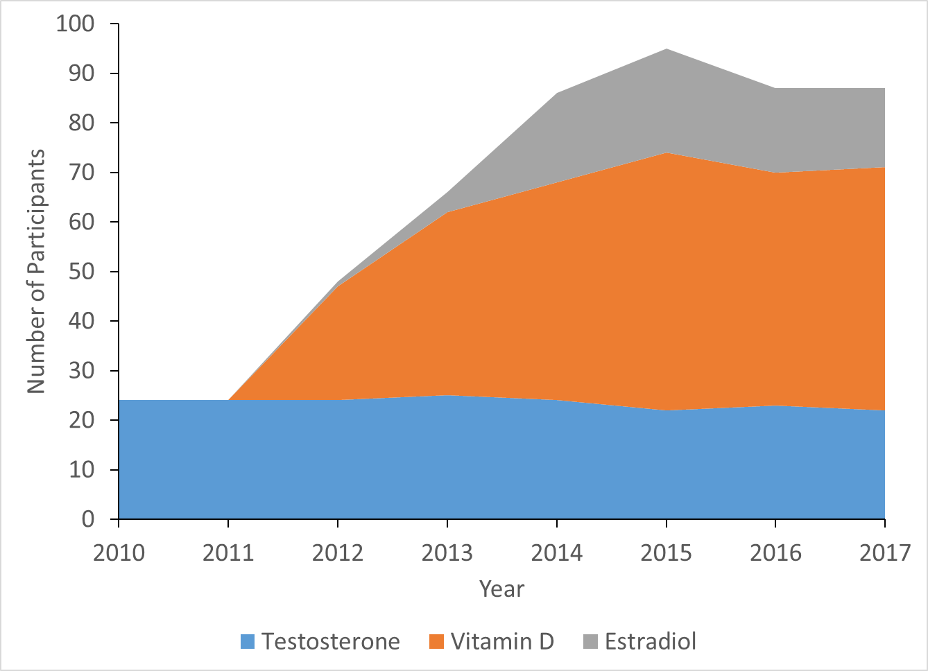
Participation in CDC’s Clinical Standardization Programs increased over 5-fold since 2010
Enrollments in CDC Hormones and Vitamin D Standardization Programs
Participation in CDCs programs is voluntary
Not every program participant achieves appropriate accuracy and precision (standardization)
Not every assay currently used in patient care is standardized Standardized assays are listed on CDC’s Website
https://www.cdc.gov/labstandards/
Notes:
CDC’s programs are unique and supported by professional organizations such as AACC and ES, the private sector, and other agencies such as FDA.

Slide 15
Study by RTI International found that the
CDC Lipid Harmonization Program resulted
in a cost benefit of
$338 million to $7.6 billion per year
Hoerger Prev Chronic Dis. 2011 Nov;8(6):A136.

Slide 16
Thank You
https://www.cdc.gov/labstandards/
Use of trade names and commercial sources is for identification only and does not constitute endorsement by the U.S. Department of Health and Human Services, or the U.S. Centers for Disease Control and Prevention.

